Slide 1
Population of the unemployed aged 25-34 by level of education (thousands).
Labor supply and demand aged 25-34 by educational attainment level (thousands)
Primary education
Secondary education
Tertiary education
Data source: Eurostat

Slide 2
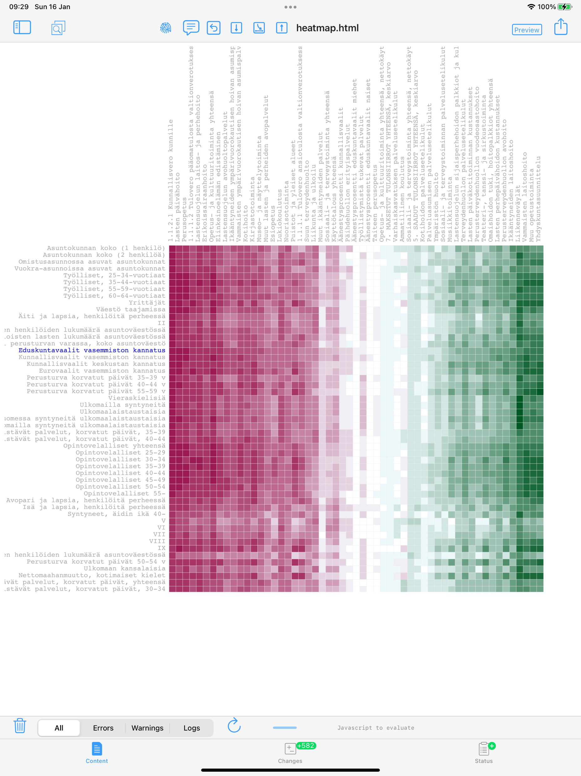
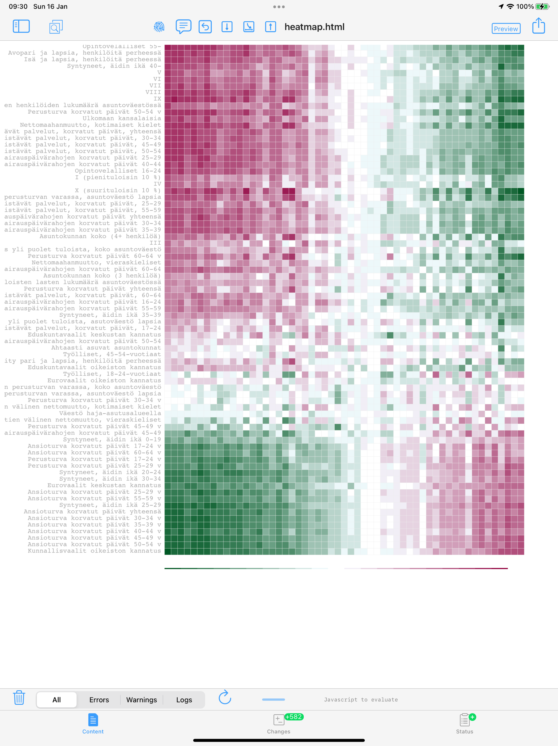

Slide 3
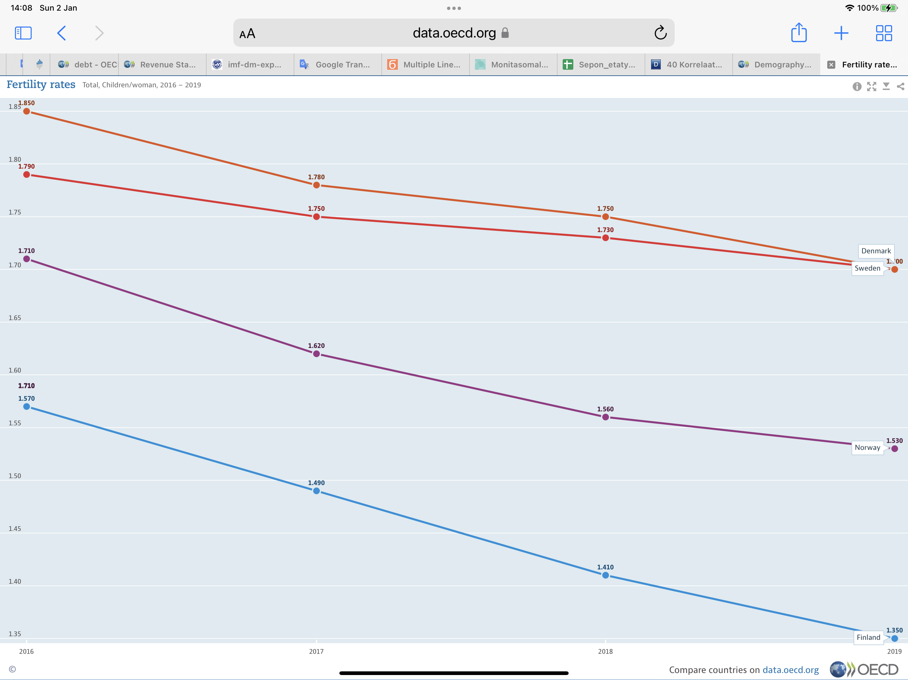
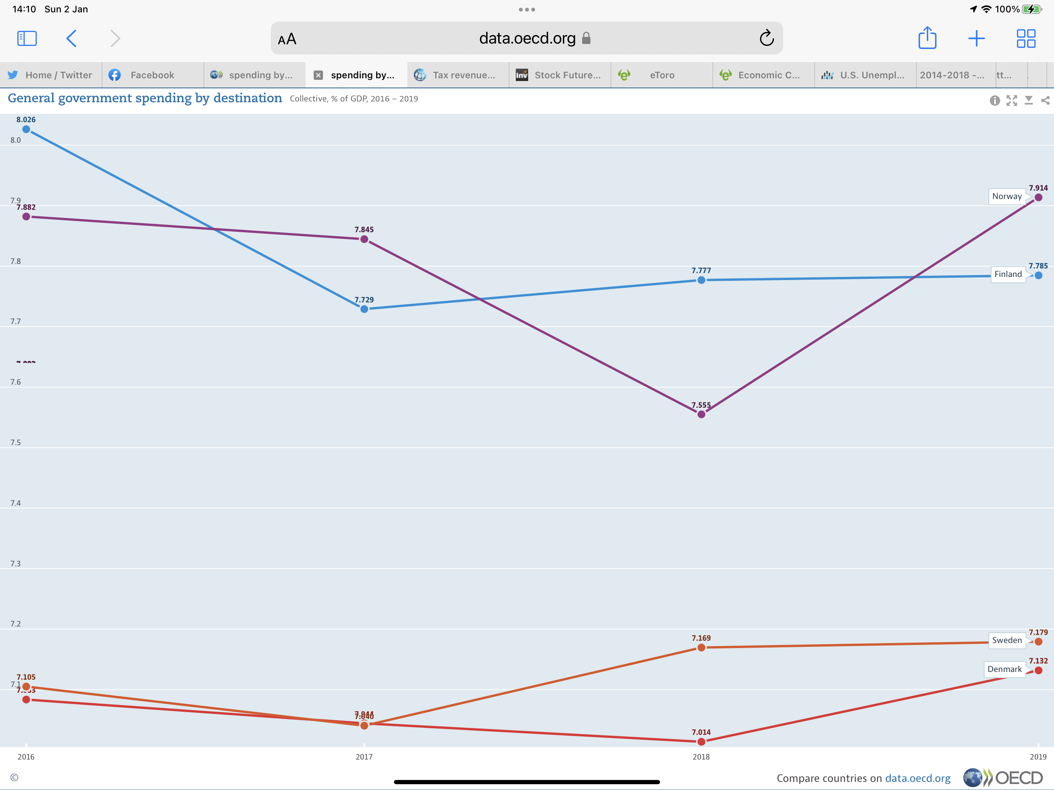
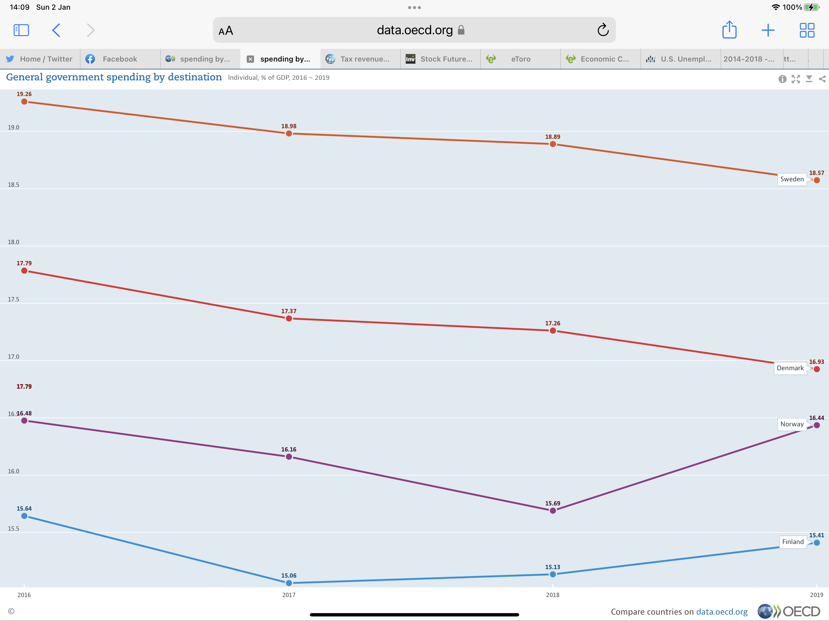
Definition of General government spending by destination
General government final consumption can be broken down into two distinct groups. The first reflects expenditures for collective consumption (defence, justice, etc.) that benefit the society as a whole, or large parts of society, and are often known as public goods and services. The second, referred to as "individual", relates to expenditures for individual consumption (health care, housing, education, etc.), incurred by government for the benefit of individual households.The two measures are calculated as percentage of gross domestic product.

Slide 5
